Slide 1
OCBC Hackathon
Analytics 2
Mihir Chhiber
Jaylene Koh
Bhavesh Chainani
Aw Xin Min
Hong Xiang
Notes:
Good afternoon judges, I am Xin Min and together with me I have my groupmates from group 2 and we have chosen challenge statement 2 for our presentation. Let me start the presentation proper.

Slide 2
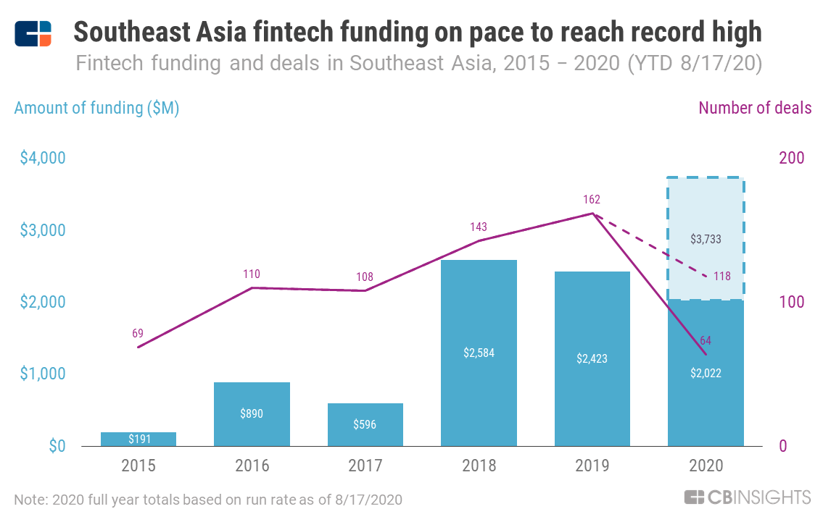
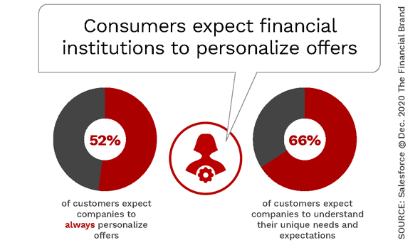
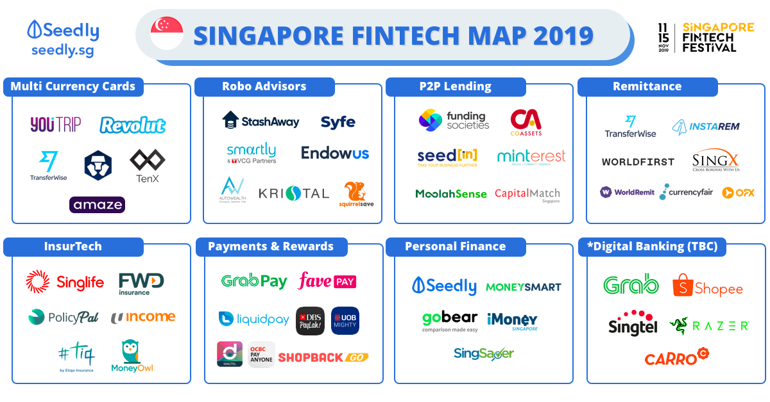
01 DIGITAL TRENDS
INCREASING CUSTOMER EXPECTATIONS & DEMANDS
RISE OF MORE PLAYERS IN THE COMPETITIVE LANDSCAPE
Notes:
The digital revolution is disrupting the relationship banks have with their customers. Accustomed to the service standards set by consumer internet companies, today’s customers have come to expect the same degree of consistency, convenience, and personalization from financial institutions.
According to salesforce, 52% of consumers expect offers by financial institutions to always be personalized and 66% of today’s customers expect their financial institution to understand their unique needs and expectations. A study done by JP Morgan also showed that consumers increasingly want access to information about their finances that can help them make more informed decisions about their money and financial goals. Such information include meaningful insights about their spending and saving habits.
Furthermore, in the financial-services sector, more players are entering the competitive landscape with disruptive AI-powered innovations, serving as a threat to incumbent banks. The number of emerging Fintech companies was also largely accelerated by the impact of the pandemic. According to The Economist Intelligence Unit, apart from fintech companies, 50% of bankers would also consider tech companies like Google, Facebook and Alibaba as competitors.

Slide 3
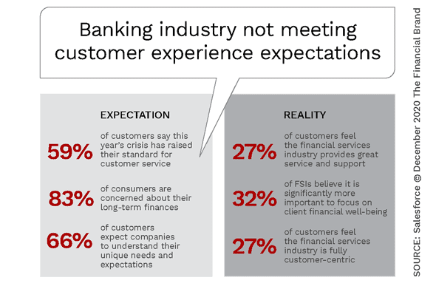
CHANGE IN CONSUMER BEHAVIOURS
Expect banks to provide a contextualised experience & personalised offers before customers request for it.
Notes:
As a result of the increasing expectations and rate of innovation, customers are expecting banks to provide a variety of products to help them achieve their financial goals, beyond just traditional products. Customers would now like banks to understand their context, needs, behavior and preferences, to gauge and anticipate their needs in real time. Unfortunately, research shows that banks are falling short of meeting such expectations. This is because banks don’t intuitively anticipate consumers’ future needs.
Thus, in order to compete in a world with increasingly blurred boundaries — where smart devices and platforms such as Google can deliver the banking experience, ride-sharing apps can supply loans, banks should leverage big data with predictive analytics capabilities to personalized offers based on the user’s purchasing and financial behavior even before the user has requested it.

Slide 4
02 OPPORTUNITIES
Opportunity for banks to tailor their investment and saving products to customer’s needs, understand their customers and provide personalisation to remain competitive.
What are the customer’s needs?
What do they expect from banks to meet their needs?
Notes:
Thank you Xin Min.
We can leverage on the trend and better position
the bank to appeal to our target audience, the
young customers. To maintain the bank's
competitive edge over other banks, now is a great
opportunity for ocbc to tailor its investment and
saving products to customer's needs, understand
its customers and provide personalisation options.
With the trend, we are no longer just selling a
product, we are selling an experience.
To do that, we need to understand two important
variable, what our customer's needs and what are
their expectations. Being able to satisfy their
needs and expectations is the key to retaining and
even gain new customers.
Looking at statistics derived from various studies
and surverys, we gained useful insights on what
we need in our solution for the bank to better meet
the expectations of customer needs.

Slide 5
Opportunities
Only 29% of youth respondents had a “great deal” of confidence in banks and financial institutions
Study by E&Y in 2018
Reason: Youth feel that current financial products or services are not tailored for them, and that new financial products and services lack innovation to address experiential youth lifestyle.
Notes:
Firstly, we saw that only 30% of young customers
are confident in banks and financial institution.
The reasons for this lack of confidence in majority
of them are due to the lack of personalisation and innovation in the products and
services offered. We need something that
is their cup of tea and aligns with their
experential youth lifestyle

Slide 6
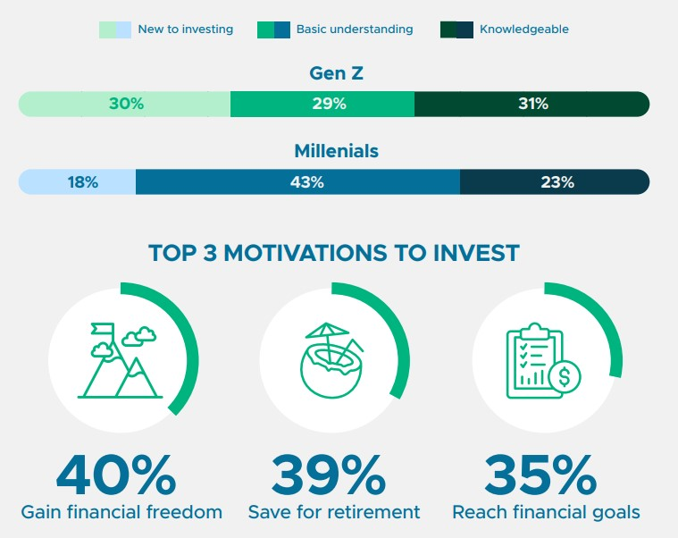
Opportunities
26% of the young customers feel that they do not have adequate knowledge and guidance
Survey by Singsaver (Aug-Sep 2020)
59% of young customers are new and have little understanding of investment
Nearly two thirds (57%) of the respondents still use a basic, low yield savings account
They want the right tools and products that empower them to make sound financial choices and remain financially resilient
Analysis by Tiger Brokers in 2020 showed that young customers are more interested to know how to invest in things they are more familiar and comfortable with.
Opportunity for continued education on personal finance
Notes:
Secondly, we see that there is an opportunity for
the bank to sell continued education on personal
finance. More than half of our young customers have
little to no understanding due to the lack of
knowledge and guidance. They do not know what to
invest in, how much to save or even how to start
saving.
There is a business opportunity for the bank to
tailor their services to target these customers to equip them with the
right tools and products to empower them to make
financial choices.
We want to give them what they are familiar and
comfortable with for higher acceptance and
engagement.
Now, i'll pass the time to bhavesh for the next
part of the presentation.

Slide 7
Solutions
Recommender Systems to achieve financial goals
Notes:
Thank you Jaylene. Building up on what my groupmates have said, our team has decided to implement a recommender system so consumer will be able to achieve financial goals. We would primarily focus on two aspects. Firstly, our recommender system would allow customers to set their financial goals and targets that is catered to each specific individual. Secondly, our system would focus on a customer’s day to day spending habits and ensure that these spending habits are in line with their future goals.

Slide 8

This is Sam
Age 24, recent University Graduate
Unsure of investments and saving schemes and hates calling call centres
Wants to purchase a landed property by 35 and retire by 55
He does not actively manage his finances day-to-day to achieve such goals
Notes:
Let us start off with Sam. Sam is a 24 year old university graduate who has a goal of wanting to purchase a landed property by 35 and retire by 55. However, he is unsure of what to invest in so as to achieve his goals. We notice that Sam isn’t the only one. We have many other clients and consumers from different age groups with different goals and aspirations. Hence, when it comes to the trends in digital banking, there is an absolute need to solve each person’s targets and goals at the comfort of their own home, be it in terms of investment or savings.
Despite the existence of various investment products provided by banks, the lack of clear recommendations on the steps to take to invest is what hinders a beginner’s investment journey. For example, Sam here may have a long term financial plan, but is unaware that daily small expenses actually play a role when it comes to achieving such goals. That is where our recommender system comes into place.

Slide 9
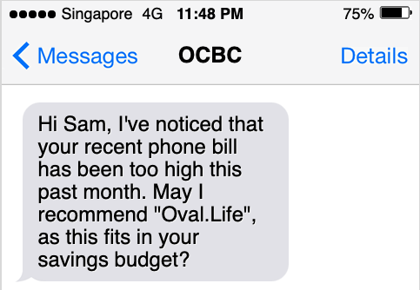
Recommender System
1.Investment Recommendations : “Hi Sam, Please input your expected future portfolio and your current financial background”
Occupation - Computer Science Student
Expected Salary - $4500
Monthly Expenditure - $1500
Current savings - $10000
Future Goals
Landed property - Yes
Age expected for the above goal - 35
Expected Retirement age - 55
Total amount of savings expected by retirement - $200,000
Other Revenue sources - none
Recommended Steps to follow to meet your goal
Loan scheme for landed property with $200 at starts and increments by 50% every year
Invest $5000 from current savings in government bonds
Full payment of the landed property by the age of 37
Expected savings by the age of 55 - $180000
2. Day to Day Savings recommendations :
Notes:
So firstly, we have investment recommendations, which would allow people such as Sam to input attributes such as his expected salary, monthly expenditure and future goals. Using a recommendation system, our proposal will be able to provide Sam with steps to meet his long term goal, focusing on various schemes and investments.
This addresses the opportunity that many people are unaware of what to invest in, as mentioned earlier. Since our target audience is anyone who wants to invest and save, such a recommender system will be able to provide each user with expected projections based on each portfolio. Now I will pass the time on to Mihir, who will explain more about day to day savings recommendations.

Slide 10
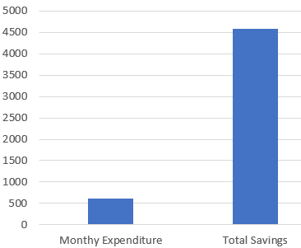
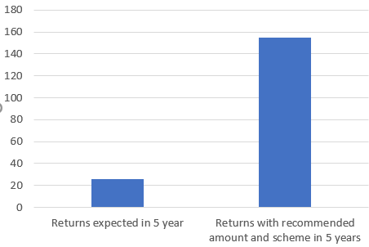
Personalisation
“Hi Sam, this is your personalised insights for your account”
For someone who may not be thinking about investments at the moment
Give insights about users projected savings with current scheme
Projected savings with the recommended scheme suggested to the user with the help of RoboInvest
Amount invested
500
4000
500
Recommended investment plan given by roboinvest
Invest 1000 in fixed deposit at an interest rate of 0.1%
Invest 1000 in OCBC secure bonds at an interest rate of 0.2%
Want to invest smart, create your personalised goals here
Notes:
Thank you Bhavesh
Day-to-Day Saving recommendation keeps track of your daily expenditures and analyses your financial transactions in real time to recommend more cost efficient alternative to make the most out of the users money. It alerts and reminds user if irregular expenditure patterns are observed. This ensures that the users’ day to day expenditures helps the user achieve his long term financial goals.
Personalisation : For the population who may not be thinking about investments at the moment, our application can provide insights of their current portfolio performance and how RoboInvest could potentially boost their current portfolio by giving future insights and compare the two both the portfolios for the user. This will help motivate the youth in investing as they can look into the untapped potential of investing. Now I will pass the time on to Hong Xiang, who will explain more about our solution in context.

Slide 11
How is our recommendations innovative and different from our competitors?
Our personalised recommendations focuses on consumer’s goals as well as daily transaction history to understand and guide consumers to better achieve their financial goals in real time.
Support:
Based on fundselectorasia news regarding a survey on Singaporean, 41% of Singaporeans have no financial plan and 14% of those that have financial plan have not taken into consideration cost of inflation
Notes:
Thank you Mihir. So, how is our recommendations different from our competitors? Well, our personalized recommendations focus on both long term consumer’s goals as well as their daily transaction history to formulate a financial guide that is more suited to consumers. Consumers are actively reminded that their long term goal can only be achieved if their day-to-day savings and spending habits are aligned. To evaluate how impactful our solution is, there is a news regarding survey conducted on Singaporeans which states that 41% of Singaporeans have no financial plan and 14% of those that have financial plan do not take into consideration the cost of inflation. Thankfully, these concerns will be addressed by our personalized recommendations by taking into account predicted inflation rate.

Slide 12
How would banks benefit from this solution?
A McKinsey survey of US retail banking customers found that at the banks with the highest degree of reported customer satisfaction, deposits grew 84 percent faster than at the banks with the lowest satisfaction ratings.
Notes:
Our big question is how does banks benefit from implementing this solution? Our personalised solution aims to improve customers’ satisfaction by playing an active role in the customer’s financial journey. A survey on US retail banking customers reveals that banks with highest degree of reported customer satisfaction grew 84% faster in terms of deposit compared with banks with lowest satisfaction ratings. As banking customers are demanding more for personal financial recommendations, this would improve deposit growth in bank.

Slide 13
Thank You
Q & A
Notes:
That’s all and thank you for listening. We will take questions now.

